Slide 1
Final Project
Abdul Baseer
MBT - 9

Slide 2
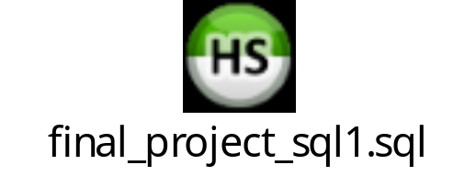
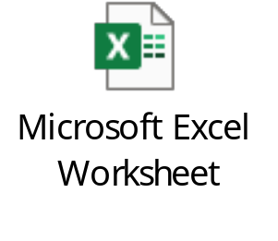
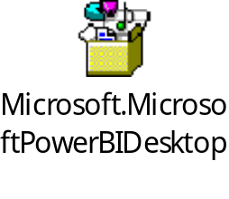
SQL :
EXCEL:
POWER BI:

Slide 3
Significant Sales Disparity: There is a significant difference in sales performance between Store ID - 2 and the other two stores.
Store ID - 2 is driving a majority of the overall sales.
Store ID - 3 is underperforming compared to the other stores.
SALES COMPARISON BETWEEN STORES AND PRODUCT
Top-Selling Products:
Trek Fuel EX 8 29 - 2016 has the highest total sales at 414,698.57.
Trek Slash 8 27.5 - 2016 and Trek Conduit+ - 2016 also have significant sales figures.

Slide 4
Marketing strategies
Continue Focusing on High-Performing Products: Maintain marketing efforts for top-selling products like Trek Fuel EX 8 29 - 2016.
Product Diversification: Explore introducing new products or variants within popular categories to attract a wider customer base.
Customer Feedback Analysis: Gather customer feedback to understand preferences and identify areas for improvement.
Marketing Channel Optimization: Evaluate the effectiveness of different marketing channels (e.g., online advertising, social media,
content marketing) and allocate resources accordingly.
Data-Driven Decision Making: Utilize data analytics to track sales performance, identify trends, and inform future marketing strategies.

Slide 5
Top Cities by Customer Count:
Mount Vernon has the highest number of customers with 20.
Ballston Spa and Scarsdale follow closely with 17 customers each.
Canandaigua has 14 customers.
The remaining cities have 13 or fewer customers.

Slide 6
Customer Insights
Targeted Marketing: Focus marketing efforts on cities with lower customer counts to attract more customers.
Customer Segmentation: Identify specific customer segments within each city and tailor marketing strategies accordingly.
Customer Satisfaction: Analyze customer satisfaction levels in each city to identify areas for improvement.
By conducting a thorough analysis of customer distribution across different cities, you can gain valuable insights into your business's customer base and identify opportunities for growth and expansion.

Slide 7
Average Ageing for each order is 1.98 days
Order Fulfillment Optimization
Optimize routes & track deliveries in real-time.
Automate order processing for faster fulfillment.
Provide real-time tracking for customers.
Manage inventory effectively:
Maintain accurate stock levels.
Efficiently replenish products.
Optimize routes & packaging:
Use software for efficient routes.
Consolidate deliveries for efficiency.
Protect products with proper packaging and handling.
Communicate proactively:
Keep customers informed with regular updates.
Offer multiple communication channels.
Monitor performance & improve:
Track key metrics (on-time delivery, average time, customer satisfaction).
Use data analytics for continuous improvement.
By implementing these strategies, you can optimize delivery, improve customer satisfaction, and reduce costs.

Slide 8
Inventory Management:
Optimize inventory:
Calculate optimal stock levels based on demand, lead times, and desired service.
Maintain safety stock for unexpected demand.
Categorize products by value and usage for focused management.
Track and monitor inventory:
Use real-time visibility systems.
Rotate stock using FIFO or LIFO methods.
Conduct regular inventory audits.

Slide 9
Staff Performance Evaluation:
Employee Rewards
Performance-Based Rewards: Implement a reward system that recognizes and incentivizes high-performing employees, particularly those in Store 2.
Team Incentives: Consider team-based rewards to foster collaboration and teamwork among employees.
Recognition Programs: Acknowledge and appreciate employee contributions through regular recognition programs.

Slide 10
Market Trend Analysis:
Customer Segmentation: Divide your target market into smaller segments based on demographics, preferences, or behavior to tailor your marketing efforts.
Value Proposition: Clearly articulate the unique value proposition of your product or service and how it benefits customers.
Market Testing: Conduct market testing to validate your product or service concept and gather feedback.
Continuous Monitoring: Continuously monitor market trends and customer feedback to adapt your strategies as needed.
By following these strategies, you can effectively discover market opportunities, understand consumer needs, and develop products and marketing strategies that resonate with your target audience.

Slide 11
Business Growth Strategy
Expand Product Line: Introduce new products or variants within popular categories to attract a wider customer base.
Target New Markets: Explore opportunities in different geographic regions or customer segments.
Diversify Product Categories: Consider diversifying into complementary product categories to reduce reliance on a single product line.
Value-Added Services: Offer additional services (e.g., bike rentals, repairs) to increase customer value and generate additional revenue.
Partnerships and Collaborations: Collaborate with other businesses or brands to expand market reach and cross-promote products.

Slide 12
Financial Reporting
Financial Reporting Recommendations:
Regular reporting: Generate reports monthly, quarterly, or annually.
Track KPIs: Monitor key financial metrics for performance.
Compare to benchmarks: Analyze performance over time and against industry standards.
Control costs: Implement measures to reduce expenses.
Visualize data: Use charts and graphs for informed decision-making.
Benefits of Strong Financial Data:
Identify profitable products.
Allocate resources effectively.
Set and track goals.
Evaluate marketing effectiveness.
Find cost-saving opportunities.

